Slide 1
Awesome Chocolate Sales dataset

Slide 2
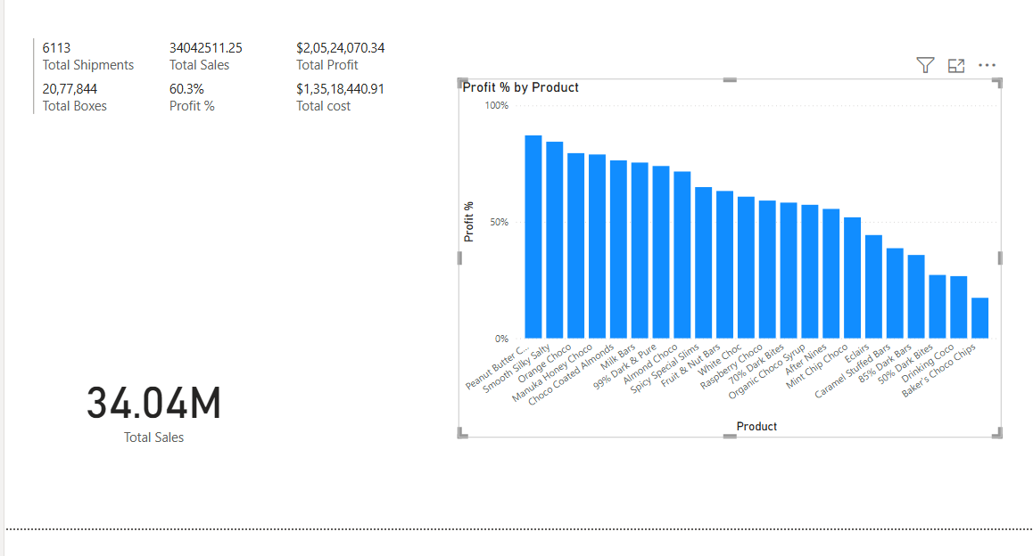
KPIs : Total sales, Total Boxes, Total Shipments, Total Costs, Total Profit, Profit % and Cards

Slide 3
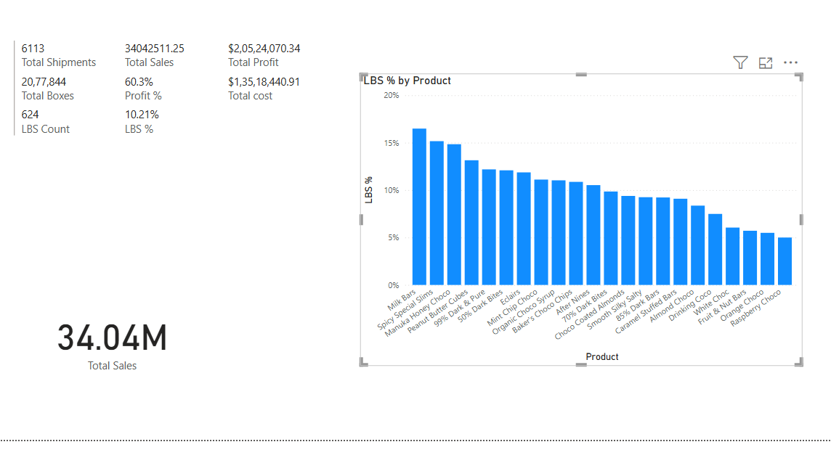
KPIs : LBS, LBS %

Slide 4
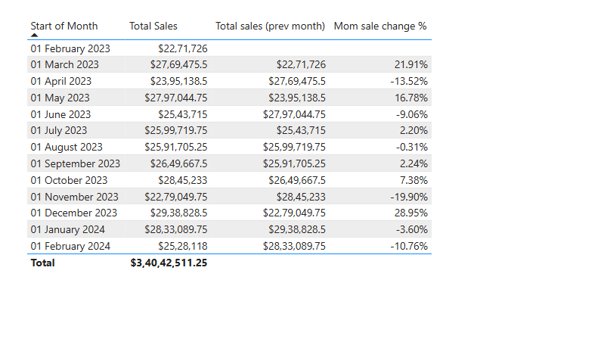
KPIs: Month in Month , year on year

Slide 5
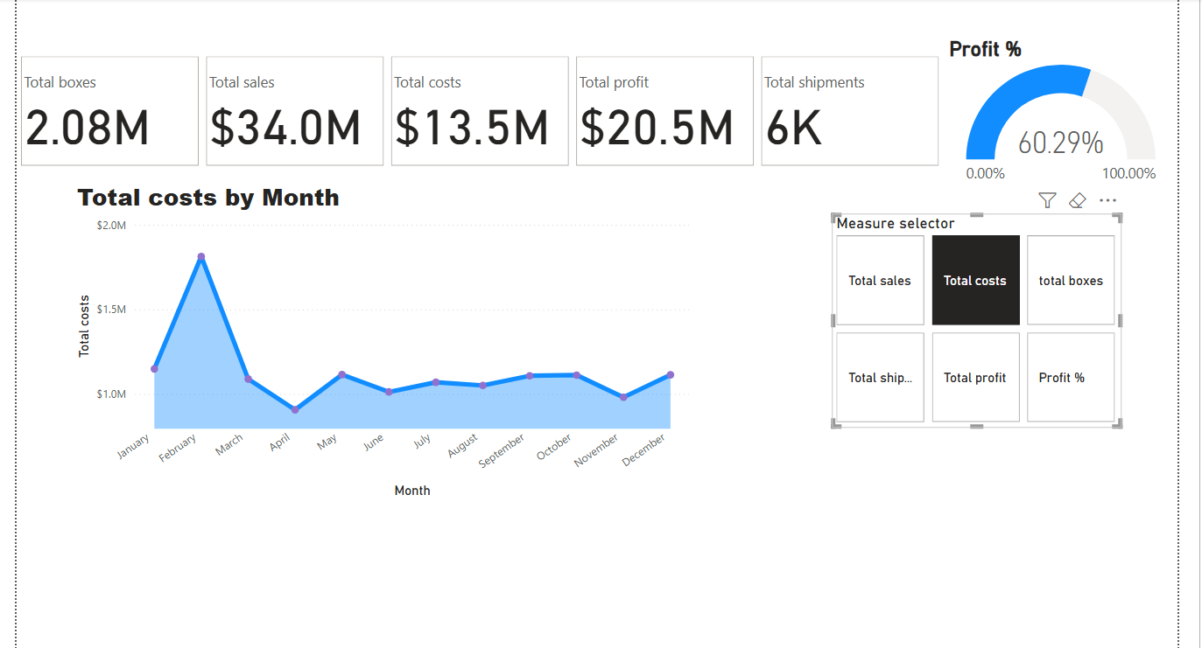
Use of slicers and cards

Slide 6
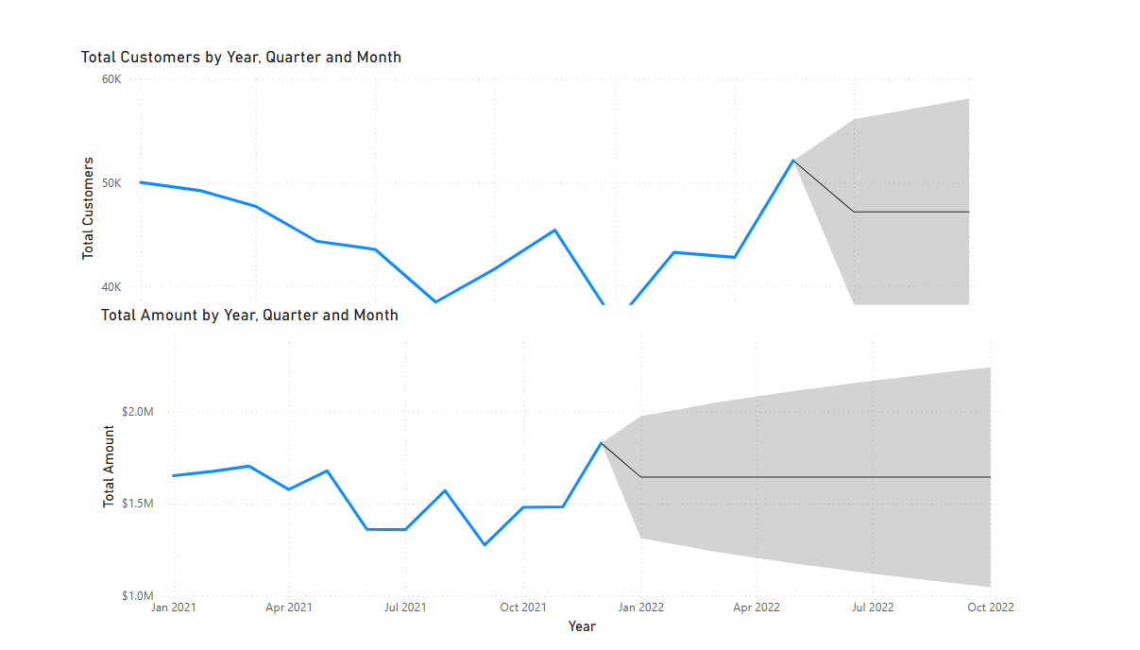
Time series forecasting

